Slide 1
Soccer Club Management System
Enhancing the Game with Technology
Presented by: Abu Bakar Siddik (19897)
Professor : Dr. Bhaskar, Vidhyacharan

Slide 2
Agenda
Introduction to the Soccer Club Management System
Entity Relationship model ER Diagram ER Diagram Explanation
Relationship Instances
Schemas
SQL Queries
Basic
Intermediate
Advanced
Conclusion

Slide 3

Introduction
The Soccer Club Management System (SCMS) is a web-based platform designed to simplify the complexities of running a soccer club. It integrates technology to manage player statistics, team coordination, match scheduling, and performance analysis, streamlining operations and enhancing decision-making to improve the overall quality of the game. The SCMS serves as the central hub for all club management activities, ensuring efficiency and smooth running in every aspect.

Slide 4
Entities And Attributes:
Player: This entity stores information about PlayerID, Name, Age, Nationality, Positions, Date of Birth.
Team: Team entity stores information about TeamID, TeamName, League.
Coach: From this entity we will find CoachID, Name, Nationality, Years of Experience (Derived from Date Started)
Match: It contains MatchID, Date, Location, Foreign Keys: TeamID_A, TeamID_B (representing the teams playing), Score_A, Score_B.
Training Session: It will hold some attributes such as SessionID, Date, Time, FocusArea.
Injury Report: From this table ReportID, Foreign Key: PlayerID, Date, InjuryType, ReportID.
Player Performance (weak relationships): Primary Keys: PlayerID, MatchID (Composite key since it depends on both Player and Match entities), GoalsScored, Assists, MinutesPlayed.

Slide 5
Entity Relationship Model
The Entity Relationship (ER) model is a framework for depicting real-world entities with distinct existences and their interconnections.
It illustrates how tables and their attributes are related.
Key elements of the ER model include sets of entities and relationships.
Applications of ER modeling include:-
Business Information Systems
Business Process Reengineering (BPR)
Educational contexts
Research
Database problem-solving

Slide 6
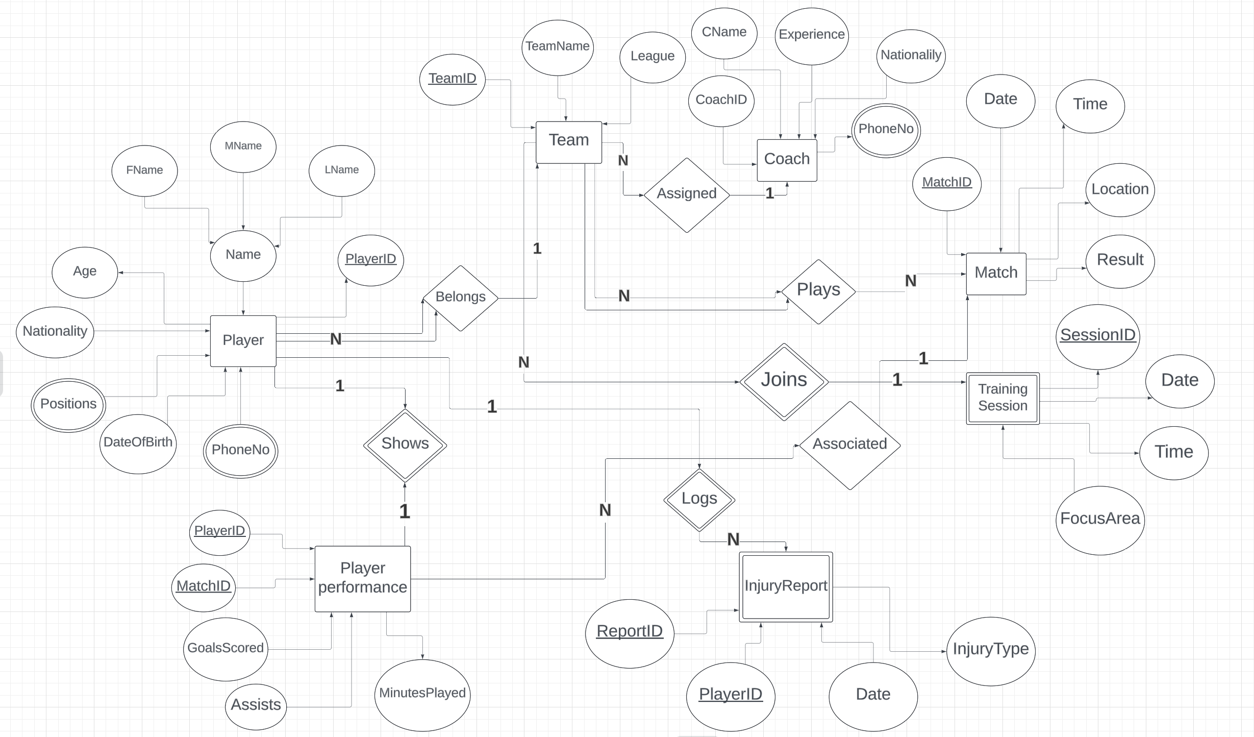
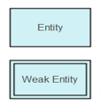
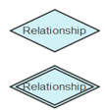

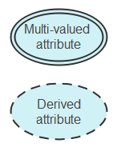
EER Diagram

Slide 7

Relationships
Player - Team Relationship (N:1): A player belongs to exactly one team, but a team can have multiple players.
Coach - Team Relationship (1:N): A coach can be assigned to multiple teams, but each team has exactly one main coach.
Match - Team Relationship (N:N): A match involves two teams and a team can play in many matches.
This relationship is many-to-many.
Player Performance - Player Relationship (1:1): A player's performance is directly linked to the player and the specific match, making it a weak relationship since it cannot exist without the player and the match.
Player Performance - Match Relationship (N:1): Each performance record is associated with one match, but a match can have multiple performance record.
Training Session - Team Relationship (1:N): A training session is specific to a team and cannot exist without the team, making it a weak entity with a weak relationship.
Injury Report - Player Relationship (N:1): An injury report is linked to a specific player and cannot exist without that player. A player can have multiple injury report.

Slide 8
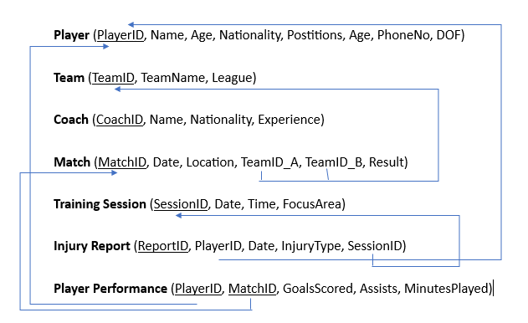
Schemas

Slide 9
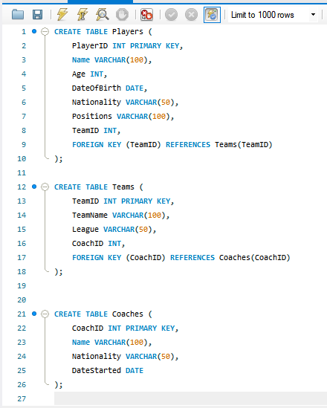
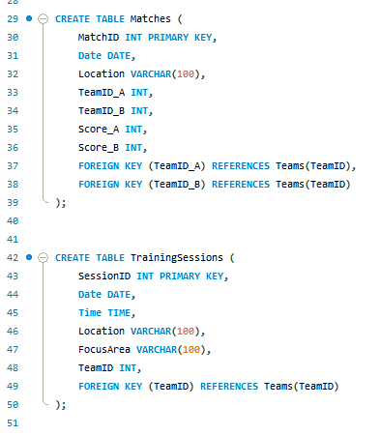
Creating Tables

Slide 10
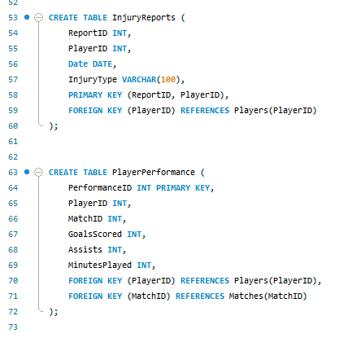
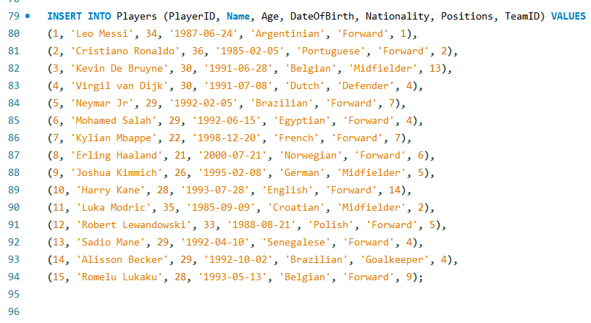
Creating Tables
Inserting Values

Slide 11
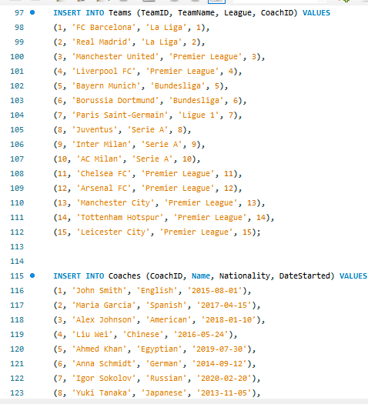
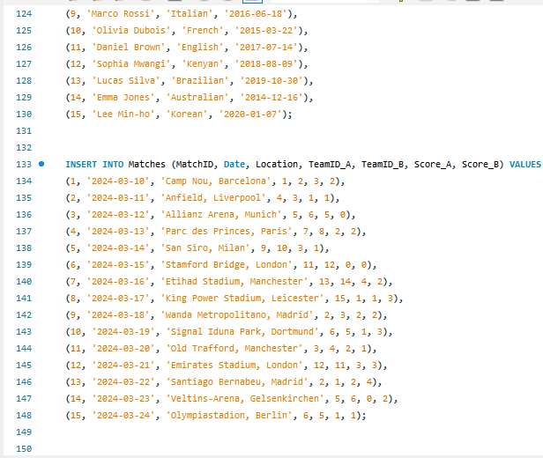

Slide 12
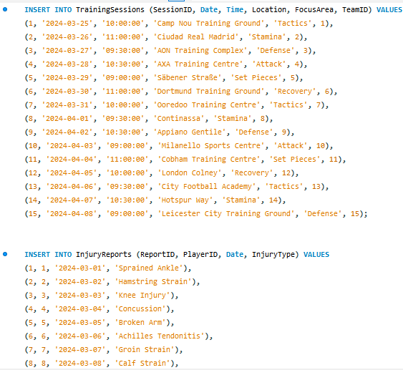
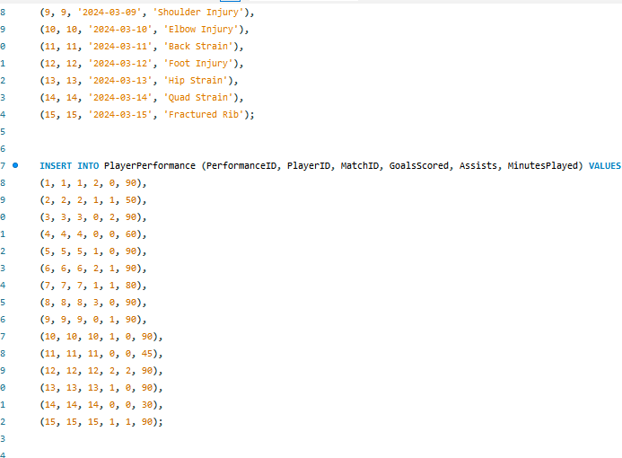

Slide 13
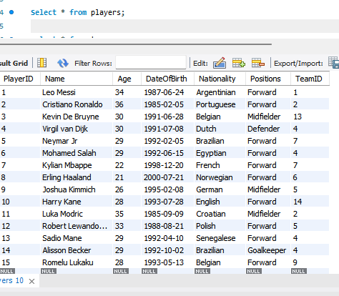
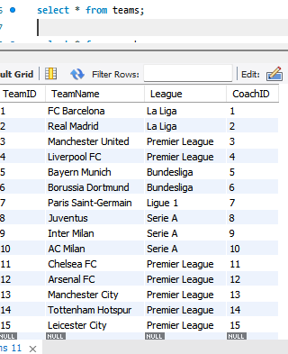
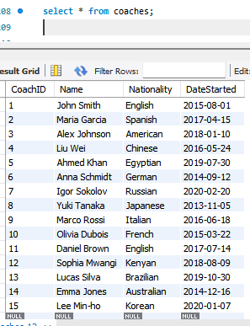
Showing the Tables

Slide 14
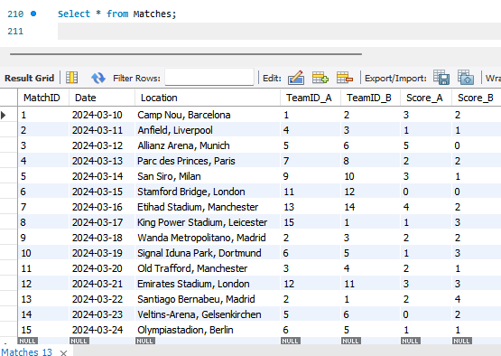
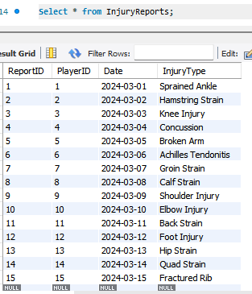
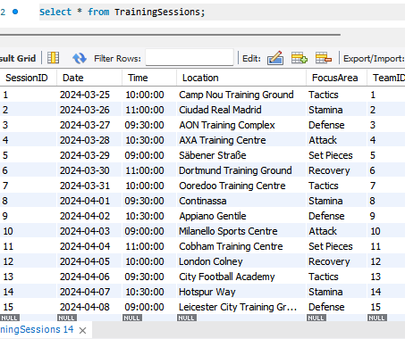
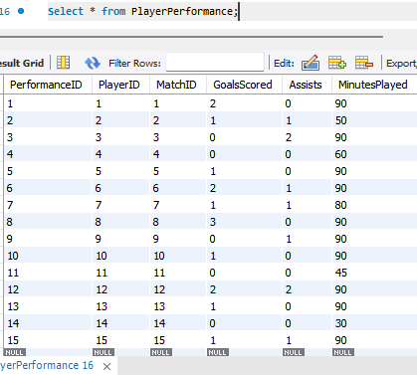

Slide 15
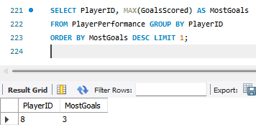
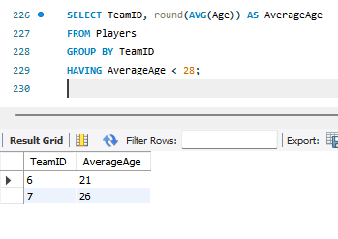
SQL Queries (Basics) - Select Based
2. (Having Clause)Retrieve teams with an average player age under 28 or Which teams have an average player age of less than 28?
SELECT TeamID, round(AVG(Age)) AS AverageAgeFROM PlayersGROUP BY TeamIDHAVING AverageAge < 28;
1. Retrieve the player with the maximum goals scored/Who scored the most goals in a single match? SELECT PlayerID, MAX(GoalsScored) AS MostGoals FROM PlayerPerformance GROUP BY PlayerID ORDER BY MostGoals DESC LIMIT 1;

Slide 16
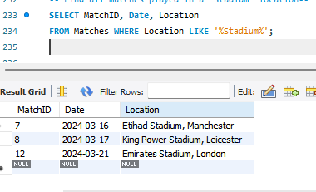
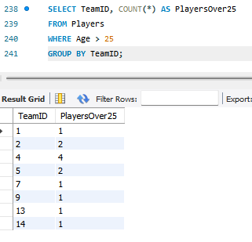
3. (Like Clause)Find all matches played in a 'Stadium’ like location Where the location name is like Stadium. SELECT MatchID, Date, Location FROM Matches WHERE Location LIKE '%Stadium%';
4. Count the number of players in each team with age greater than 25.
SELECT TeamID, COUNT(*) AS PlayersOver25
FROM Players WHERE Age > 25
GROUP BY TeamID;

Slide 17
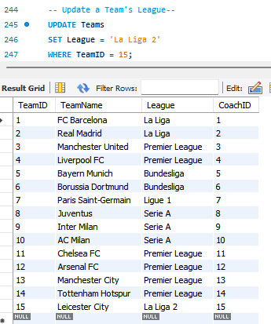
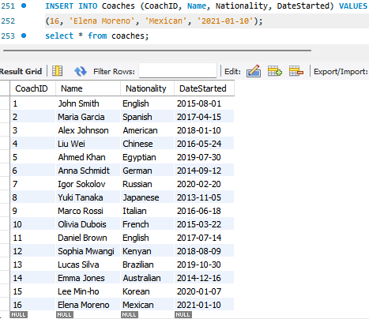
5. Update a Team's League UPDATE TeamsSET League = 'La Liga 2’ WHERE TeamID = 15; select* from teams;
6. Inserting a new record to the Coaches table.
INSERT INTO Coaches (CoachID, Name, Nationality, DateStarted) VALUES
(16, 'Elena Moreno', 'Mexican', '2021-01-10’);
select * from coaches;

Slide 18
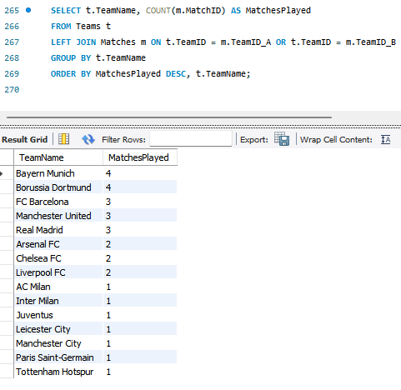
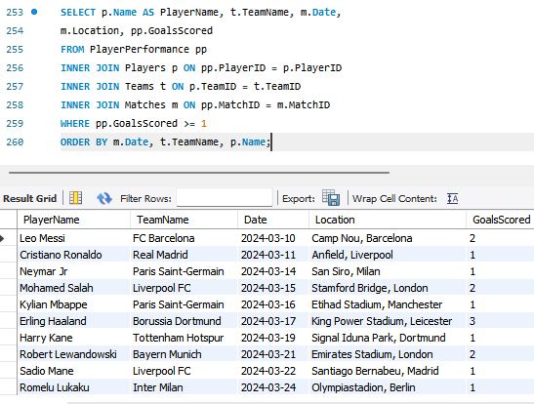
SQL Queries (Intermediate)
2. (Left Join Based) List all teams and the count of matches played.
1. (Inner Join Based) List all players with their team names and match details where they scored at least one goal.

Slide 19
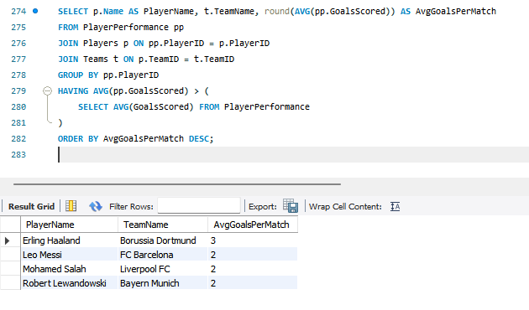
SQL Queries (Advanced) Joins and Nested Query including Aggregations
#Find all players who have an average number of goals scored per match that is above the overall average goals scored per match by all players. Additionally, list each qualifying player's name, team name, and their average goals per match.

Slide 20
Wrapping Up
And that's a wrap! We've had a fun ride through the world of SQL, seeing just how it helps keep a soccer club running smoothly. From listing out who's who on the team to diving deep into game stats, SQL is a trusty guide. It is like the coach behind the scenes, making sure we've got all the info we need to score big, both on the field and off. So, whether we are looking to pick the next star player or just keep things organized, using SQL we can simply do that without any hassal.

